Slide 1
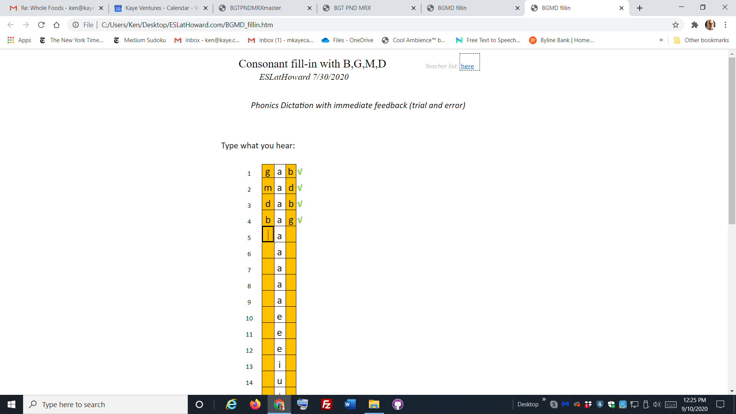
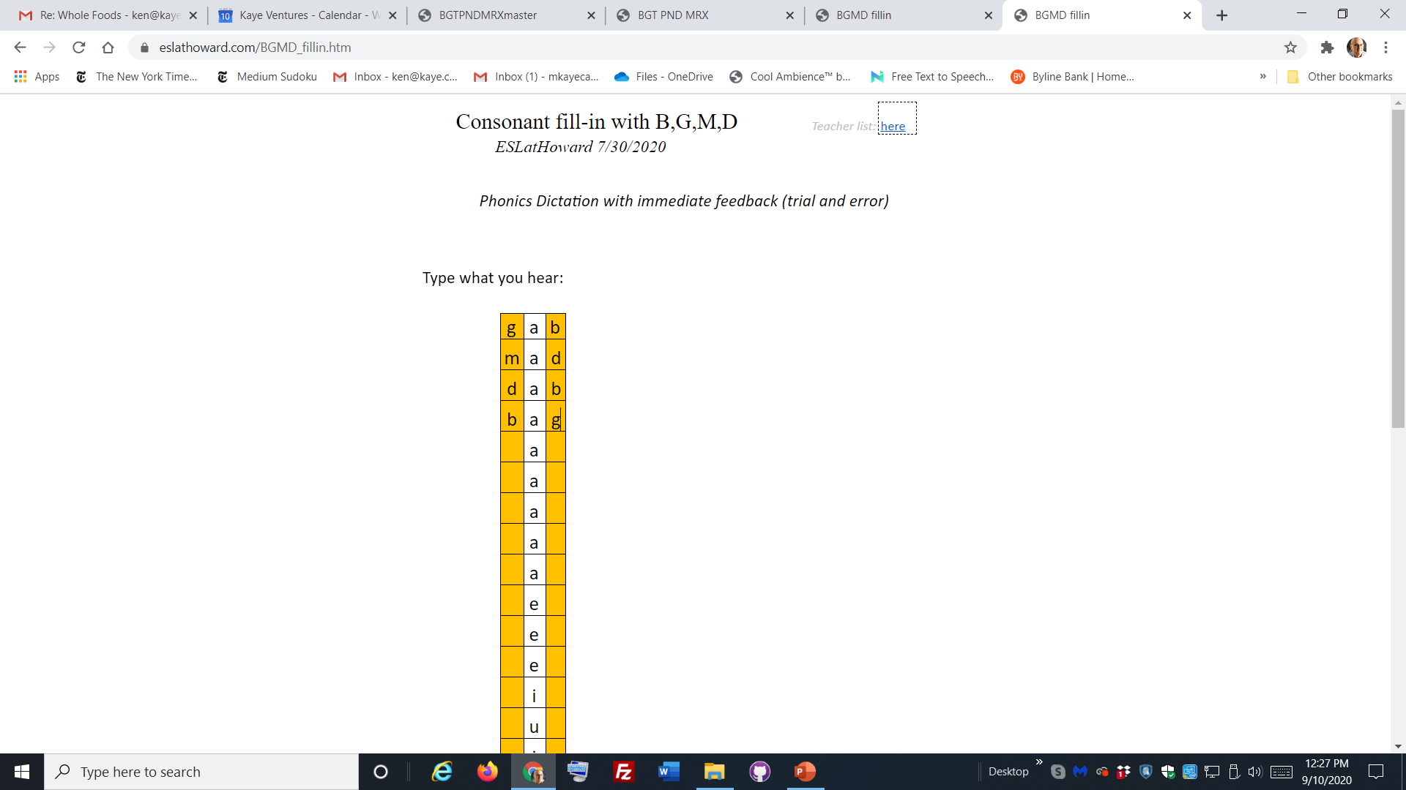
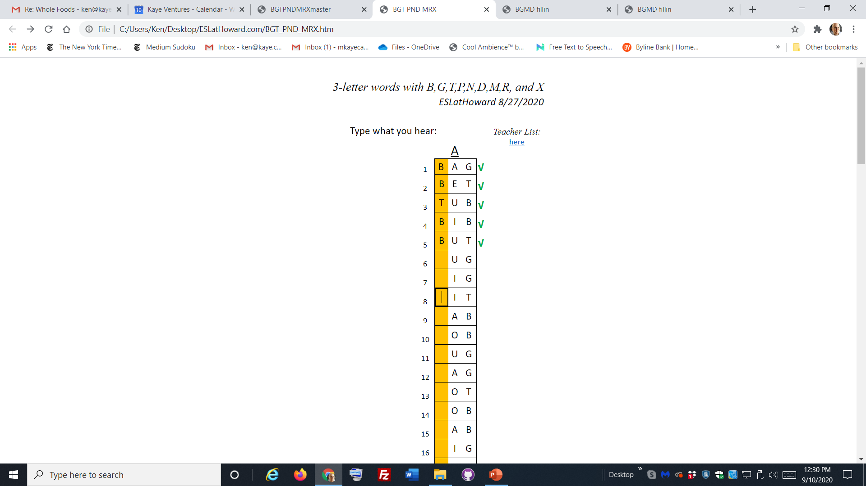

correct performance of file on my disk
same file fails to show check marks beside correct answers
correct performance of file on my disk
same file fails to show check marks beside correct answers

Slide 2
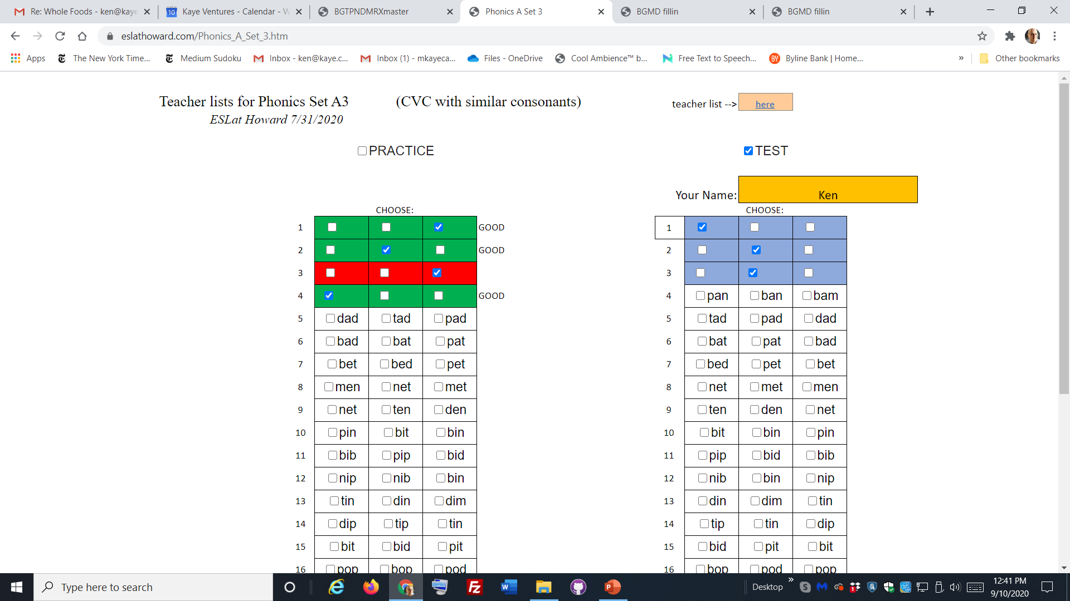
One example among dozens of programs using active conditional formats. I’ve never had one that performed perfectly from the disk fail to do so when uploaded to the domain.

